Slide 1
What makes a BF4 player great?
BF4 Data Science Analysis – Story Telling
Notes:
1

Slide 2
Overview
Rules of the game
BF4 player data-set features (36,000+ players)
Data Subsets (high level vs low level players; long hours vs standard players)
Basic Analysis (scatter plot; histograms; correlation matrices)
Further questions that need to be asked
Link to Jupyter Notebook

Slide 3
Battlefield 4
Players complete objectives with squad mates to win the game
While completing objectives players need to eliminate enemies in their way
Players get to choose different game modes that contain different objectives
Players can use different weapons and vehicles
Theoretically, winning the game requires a combination of kills, vehicle usage, heals, repair and supply collection, just like a real battlefield
However, the game stats may show that one play style triumphs the other, which is what we are trying to explore

Slide 4
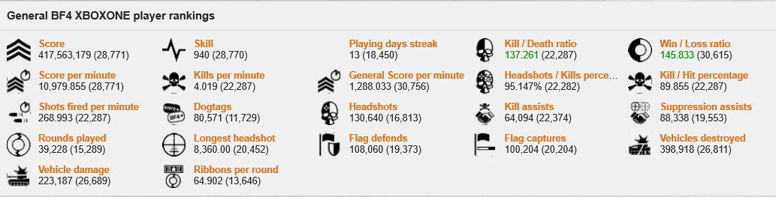
The dataset
Contains 36,000+ xbox one player performance data
Feature Examples: player_id, score, time, kills per minute, deaths per minute, game mode, weapon usage, kit usage, vehicle usage, etc.
Link to stat site page

Slide 5
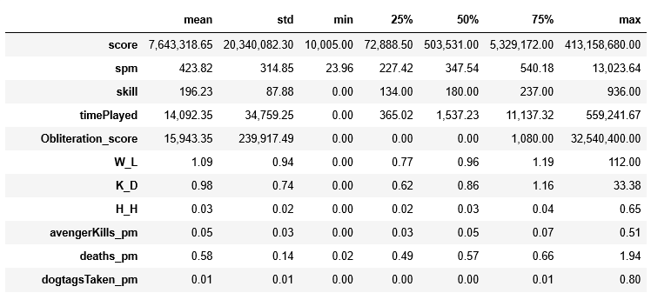
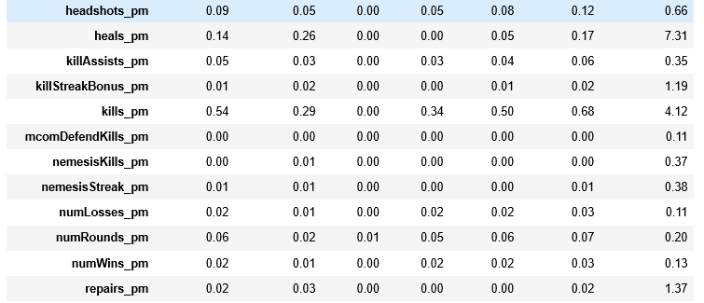
Player skill is very spread out
In the plot below we can see that player skill level and the time spent on the game are very spread out
75% of players have a skill level below 237, have less than 180 hours of gameplay and have a spm below 540
Many top level players have over 1000 hours of play time and scores of up to hundreds of million

Slide 6
Sub-setting the Data
In the analysis below, we used histograms to analyze player skill level, time played, K/D, W/L, H/H.
We want to see if more time spent playing the game lead to increase in stats.
Here, we've split the player base into three groups:
the generic player base;
the 1000-hour player;
the highly skilled players;
the low skilled players

Slide 7
More hours doesn’t mean more skillful
In the charts in the next page, we compare the stats of 1000 hour player vs generic players.
We can see small improvements made by the 1000 hour players in terms of skill, K/D, W/L.
However, there are still a good portion of 1000 hour players that are not seeing improvements in these stats, and their numbers overlap with the generic populous
We can see that headshots/hits doesn't seem to have improved.
In fact, based on the data in the chart, 1000 hour players are making less headshots within the game.

Slide 8
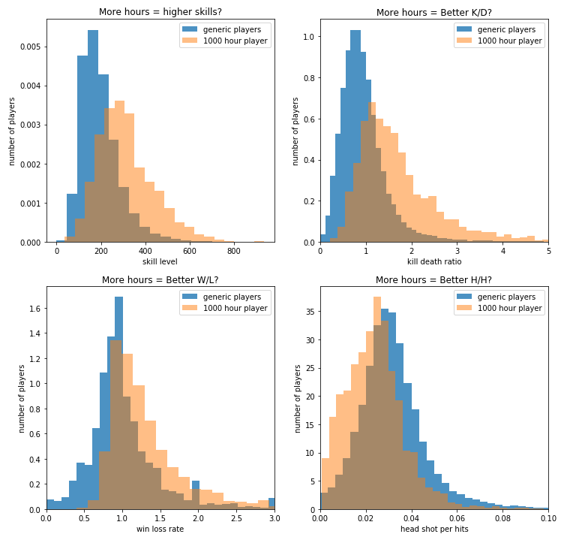

Slide 9
The game is balanced with good matchmaking
In the second series of charts, we see that highly skilled players in general seems to be making less progress in terms of Wins/Losses.
this could be that the game is auto matching high skilled players against each other to make sure the game is well-balanced.
We do see that for high skilled players, there’s an improvement in H/H, which means that H/H does play a part in improvin skill level and K/D, but not as much as one would think in terms of W/L.

Slide 10
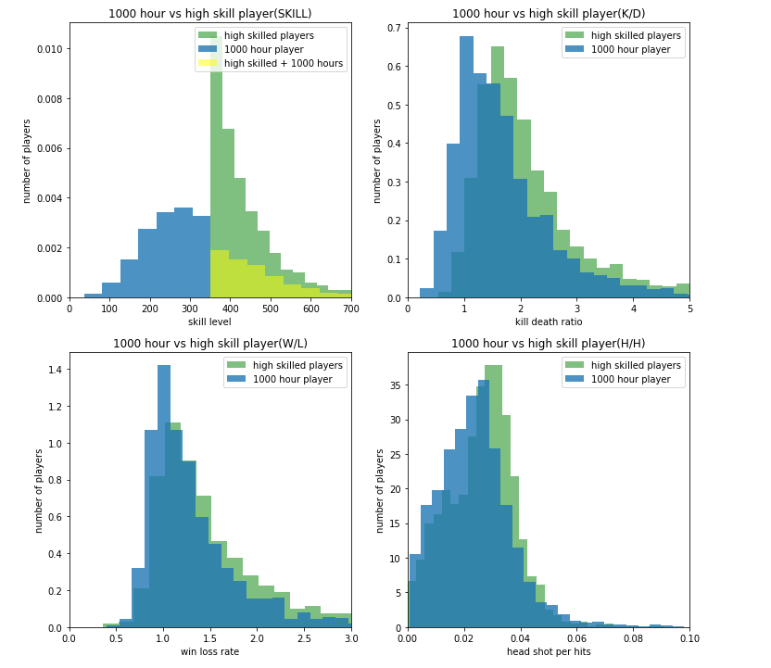

Slide 11

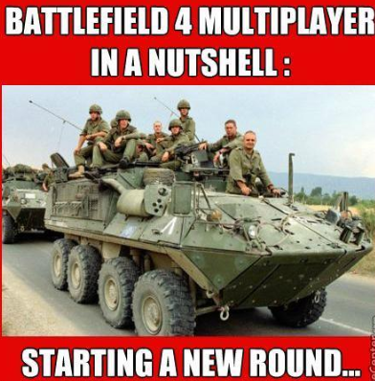
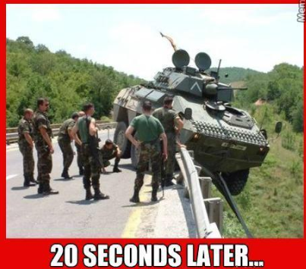
Noob vs Expert, how are they different?

Slide 12
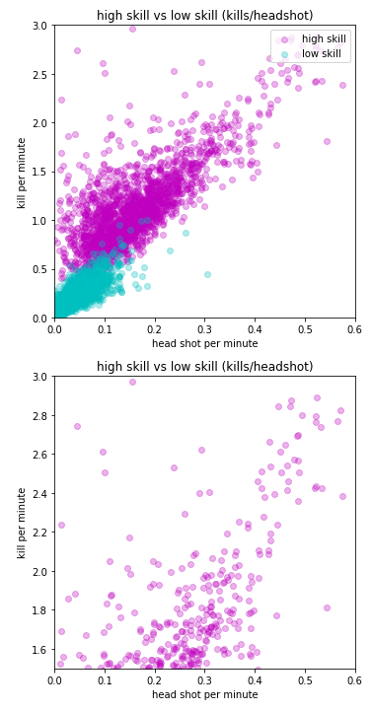
Most players can’t or don’t make consistent headshots
In the plots below, we compare the relations between "kills/minute" vs "headshots/minute", and "kills/minute" vs "deaths/minute".
We compare the data of two groups, players with high of over 350 and players with low skills below 100.
We can see from the data that low skill players have trouble making kills and getting head shots. Whereas high skilled player can make significant more headshots and kills.
While it does seem that there is a linear relation between headshots and kills made, there are still a good amount of high skilled players making kills via plain hits

Slide 13
If you are new to the game, focus on body shots or vehicle kills
Headshots per effective hit ratio seems to negatively affect the overall score and score per minute of the player
Majority of BF4 players rely on body shots instead of headshots to make kills.
A theory circulating around the gaming community is that kills requires multiple headshots, which only players on the highest skill level can achieve.

Slide 14
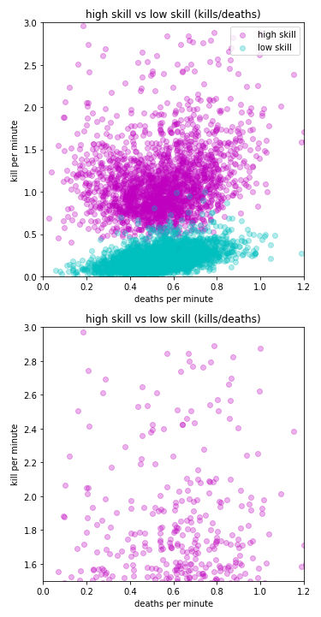
Death is inevitable, better to not think about it and ramp up more kills
On the other hand, if we look at survivability, which is counted using deaths per minute
We can see that being able to survive doesn't seem to contribute that much to the ability to make kills
The only difference here is that high skilled players kill more people, that’s all.
Players of all level die are very likely to die within 1 minute

Slide 15
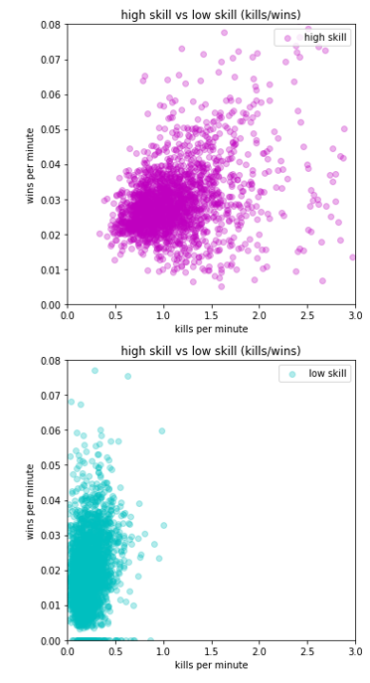
Auto matchmaking - the glass ceiling of higher win rates
High level players are able to make significantly more kills than low level players
However, their high skill level pits them against other high level players, which reduces their chances of winning
This shows that in order to move to high level rankings, you need to make more kills, but don’t expect to win more

Slide 16
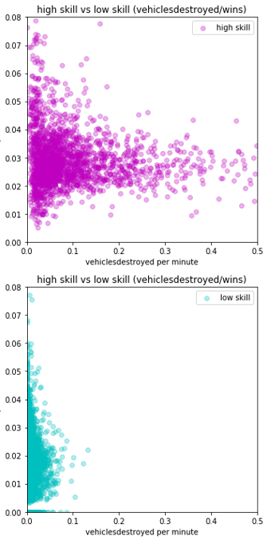
Destroy more vehicles that’s what the experts are doing
Highly skilled players are more likely to target and destroy vehicles than low level players
Though the win rate is capped, high level players understand that destroying vehicles are the key to winning
Win rate doesn’t improve even if your skill level is higher due to auto matchmaking

Slide 17
What a correlation matrix can tell us
A few conclusions we can draw are:
the more time spent playing the game, the higher score you'll get
conquest mode gives the most score per minute
headshots, assists both help with generating effective kills per minute
the game rewards players on both skill and teamplay
nemesis kills, which means killing a player repeatedly without being killed by that player, seems to contribute to kills per minute
In a matchup, there might be a low-level players that is unlucky enough to be targeted by the same high-level player

Slide 18
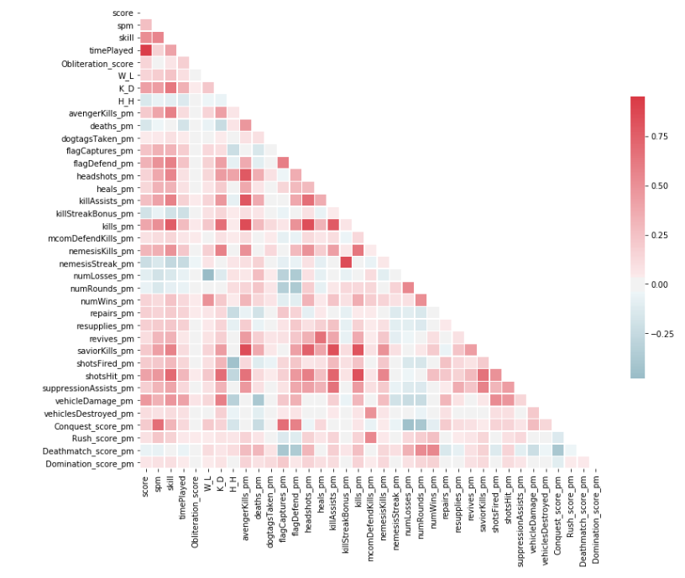

Slide 19



What we’d like to know next
What kind of weapons do players use
What kind of vehicles do players use
What are the characteristics of players who frequently play different game modes

